Slide 1




A Web-based Sales and Inventory Management System For RJTech Computers

Slide 2



USE CASE DIAGRAM

Slide 3

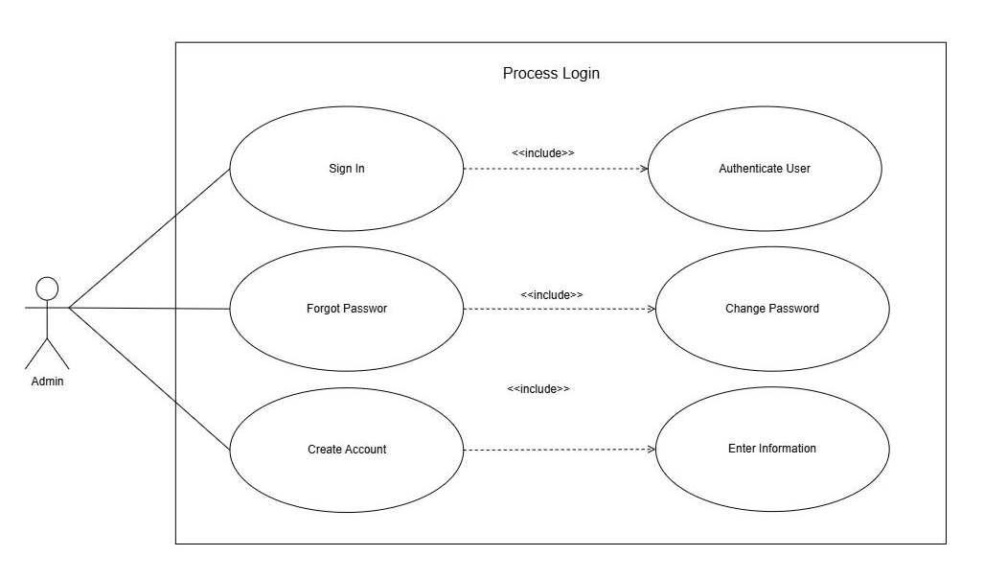
Use Case Diagram

Slide 4
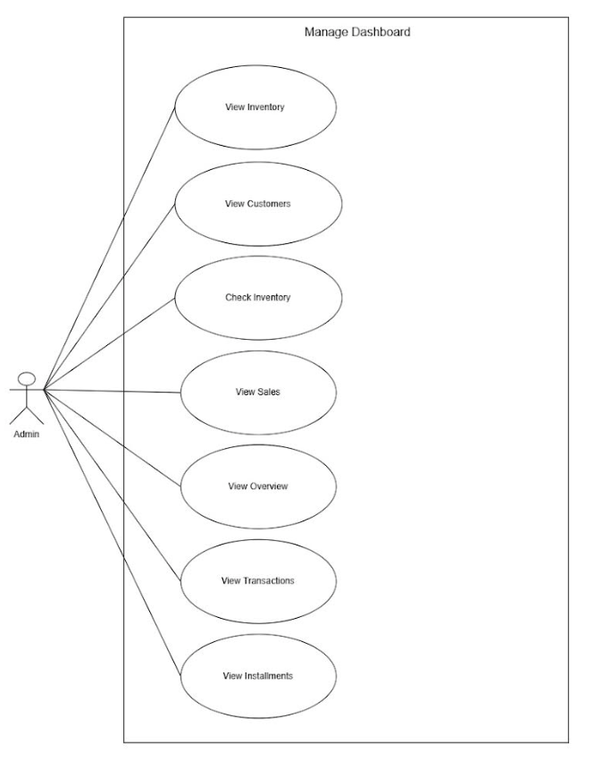
Use Case Diagram

Slide 5
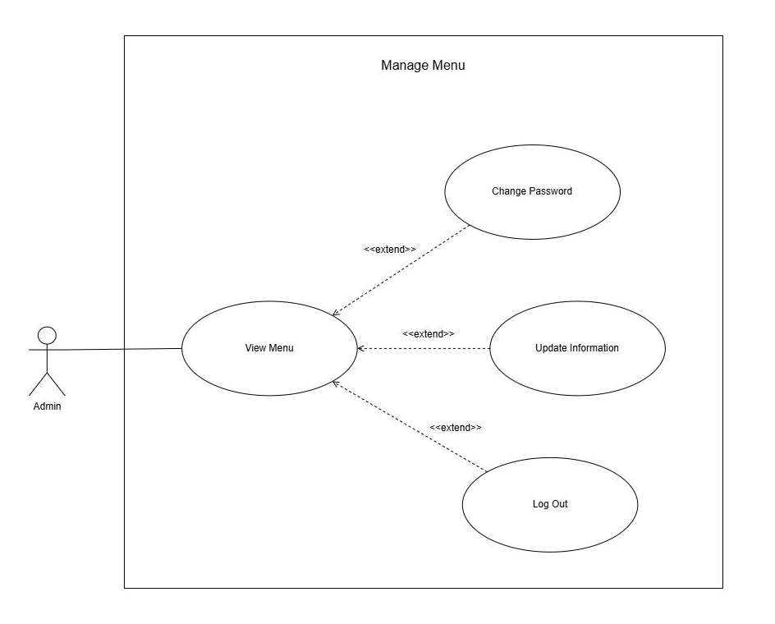
Use Case Diagram

Slide 6
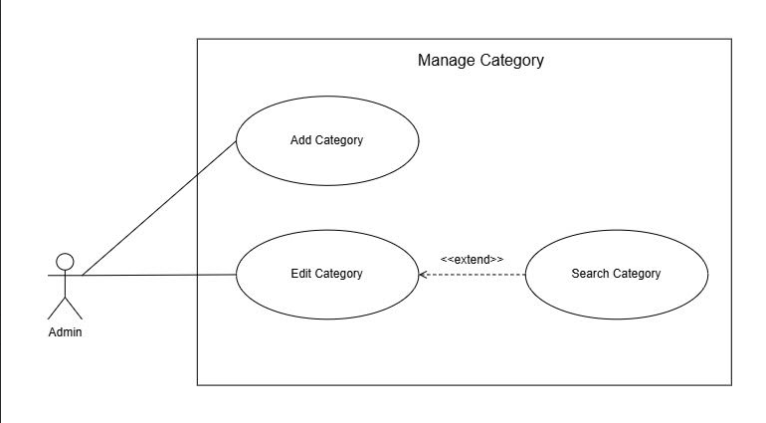
Use Case Diagram

Slide 7
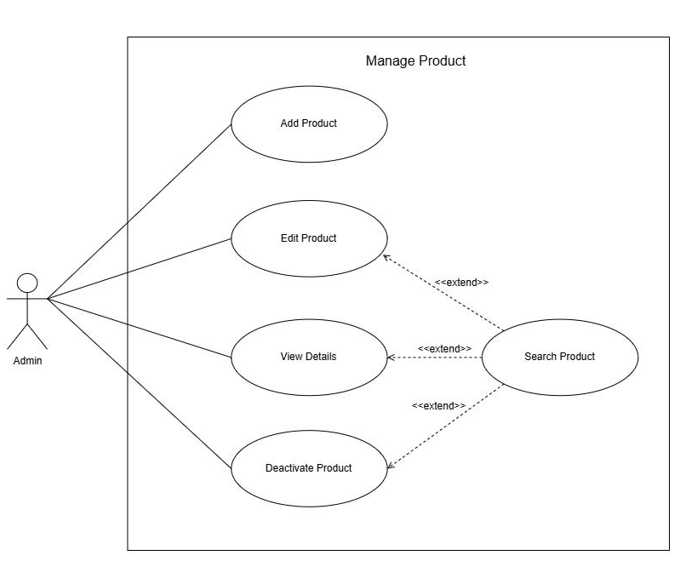
Use Case Diagram

Slide 8
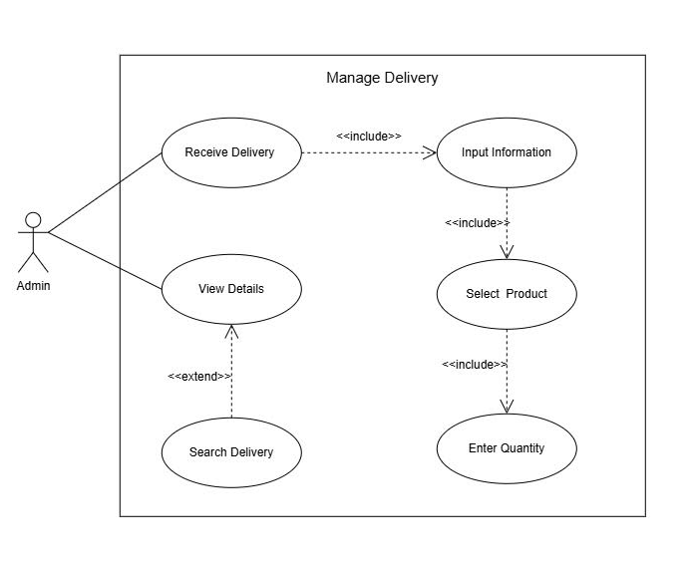
Use Case Diagram

Slide 9
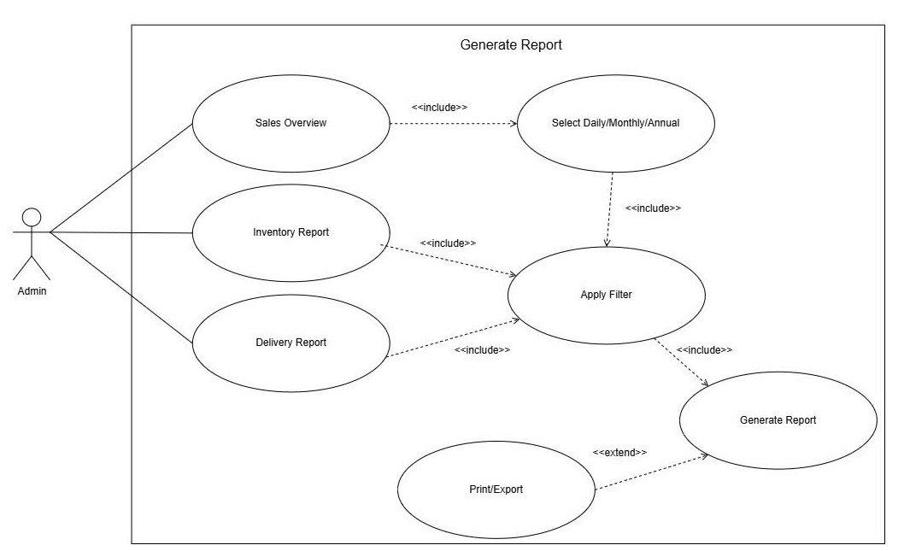
Use Case Diagram

Slide 10
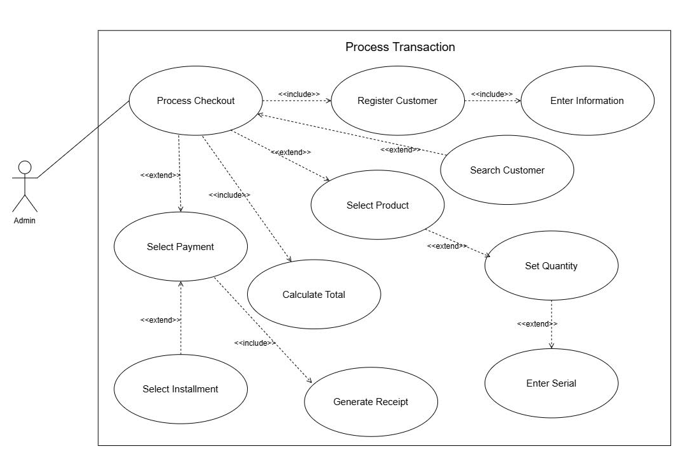
Use Case Diagram

Slide 11
Entity Relationship
Diagram and
Database Schema

Slide 12
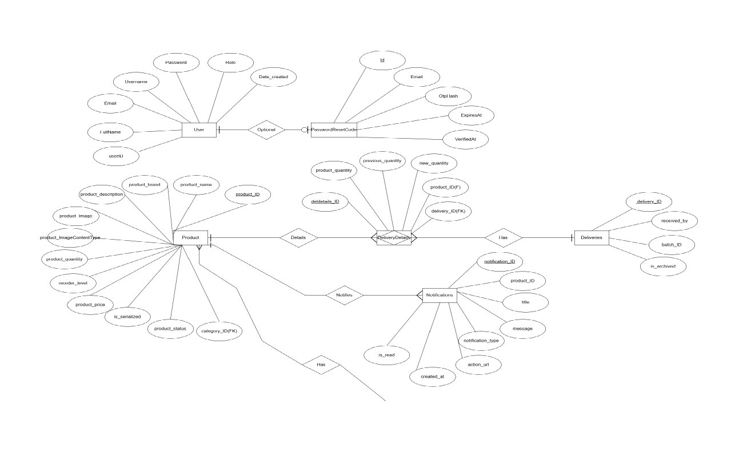
Entity Relationship Diagram

Slide 13
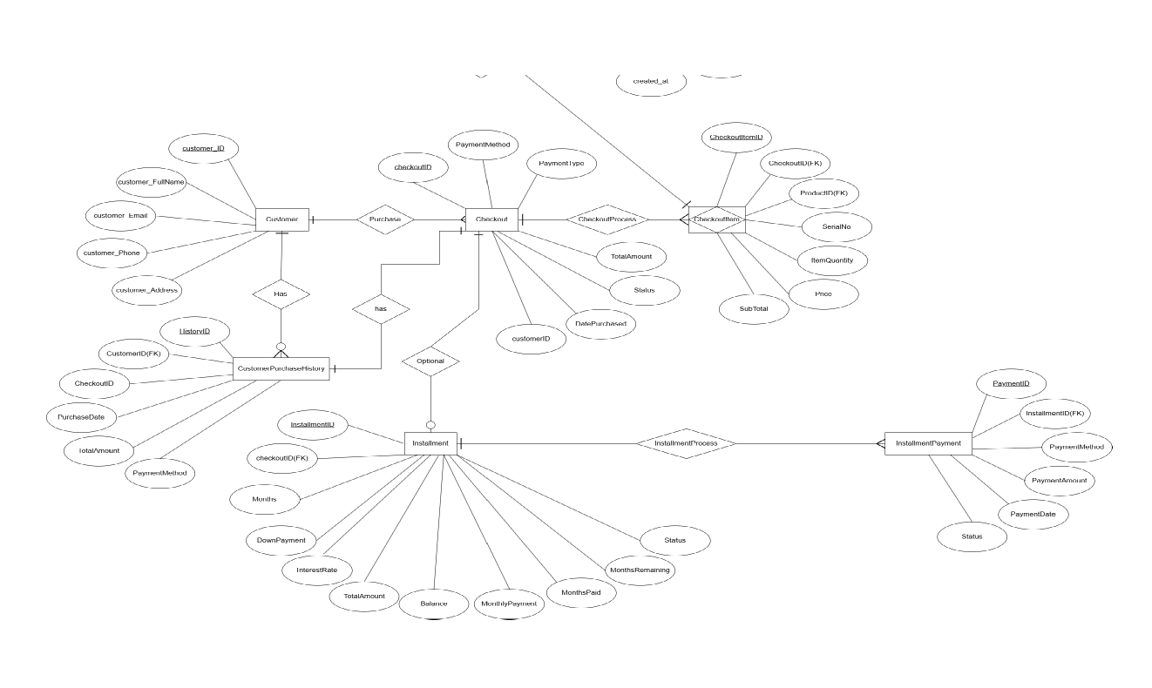
Entity Relationship Diagram

Slide 14
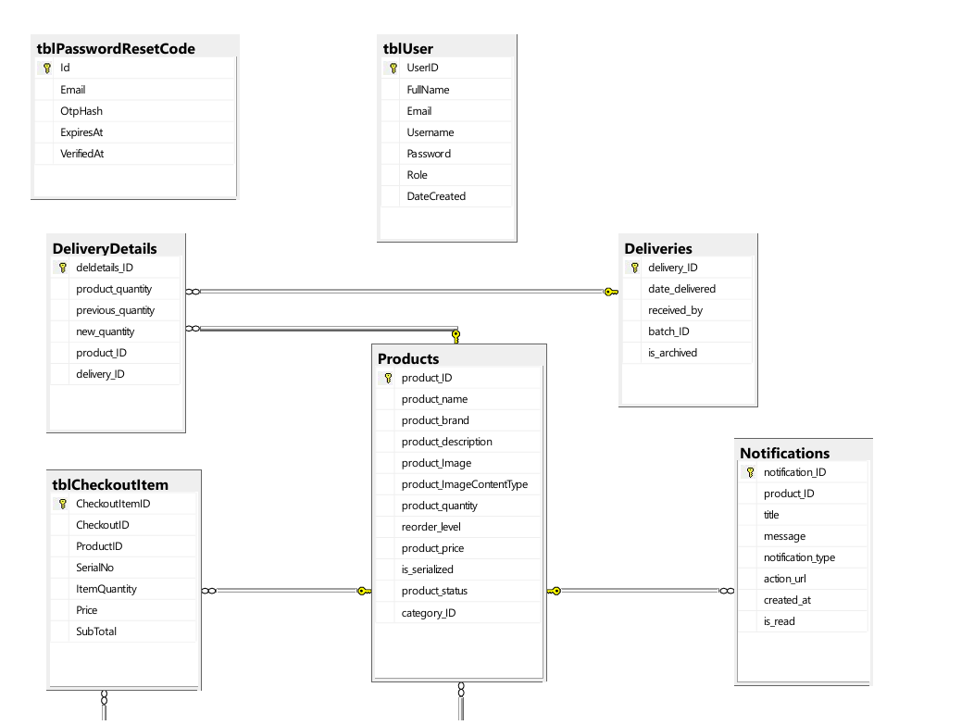
Database Schema

Slide 15
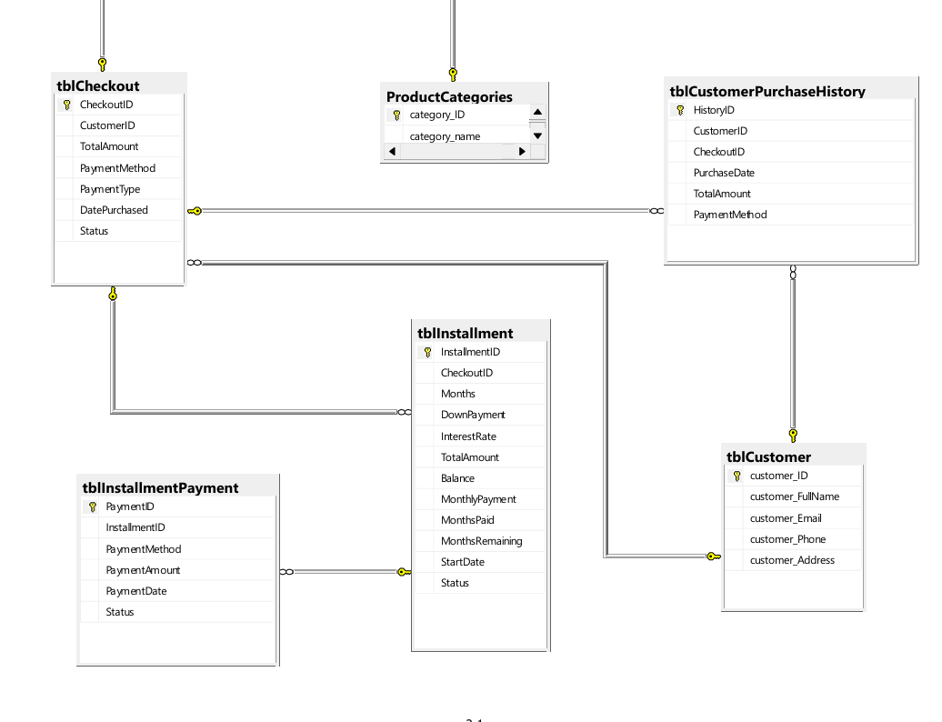
Database Schema

Slide 16
User Interface (UI)

Slide 17
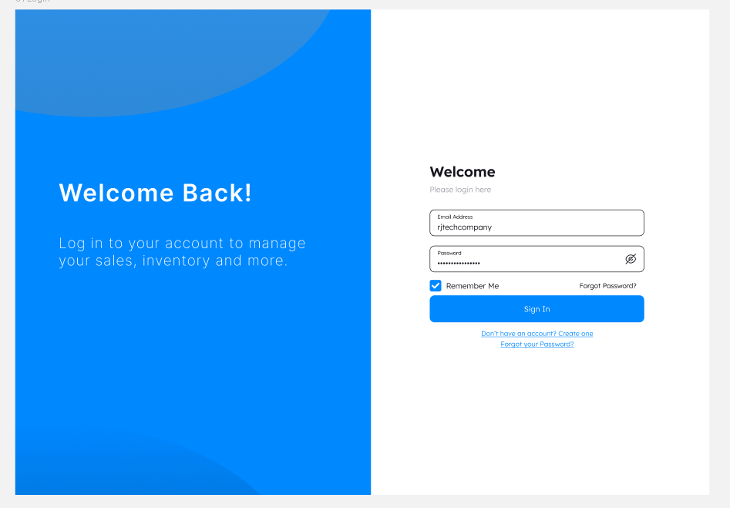
User Interface (UI)

Slide 18
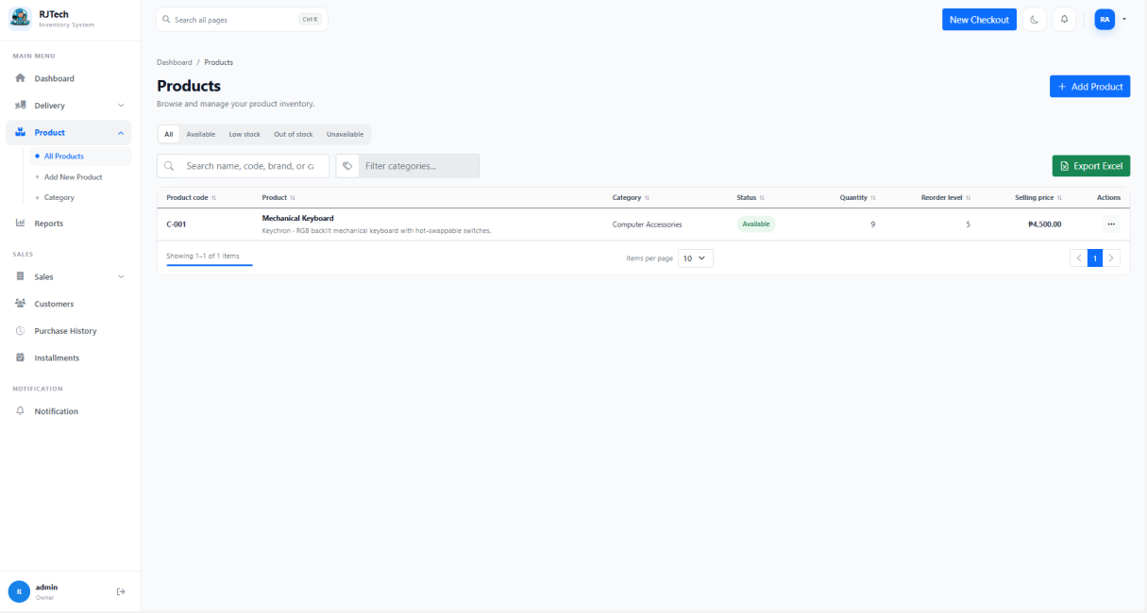
User Interface (UI)

Slide 19
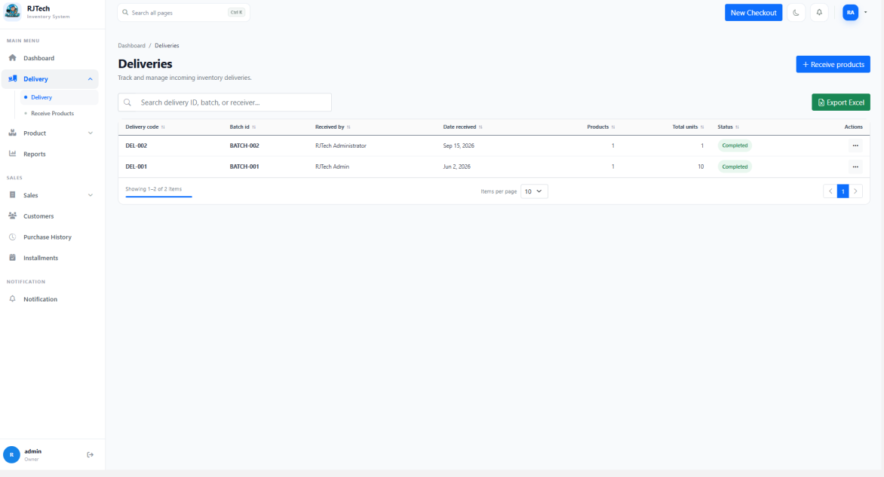
User Interface (UI)

Slide 20
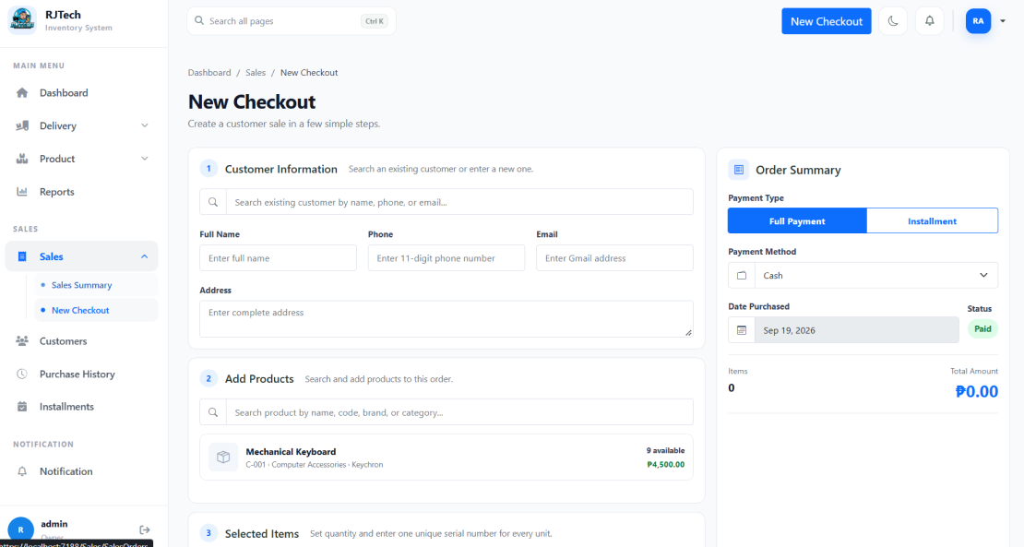
User Interface (UI)

Slide 21
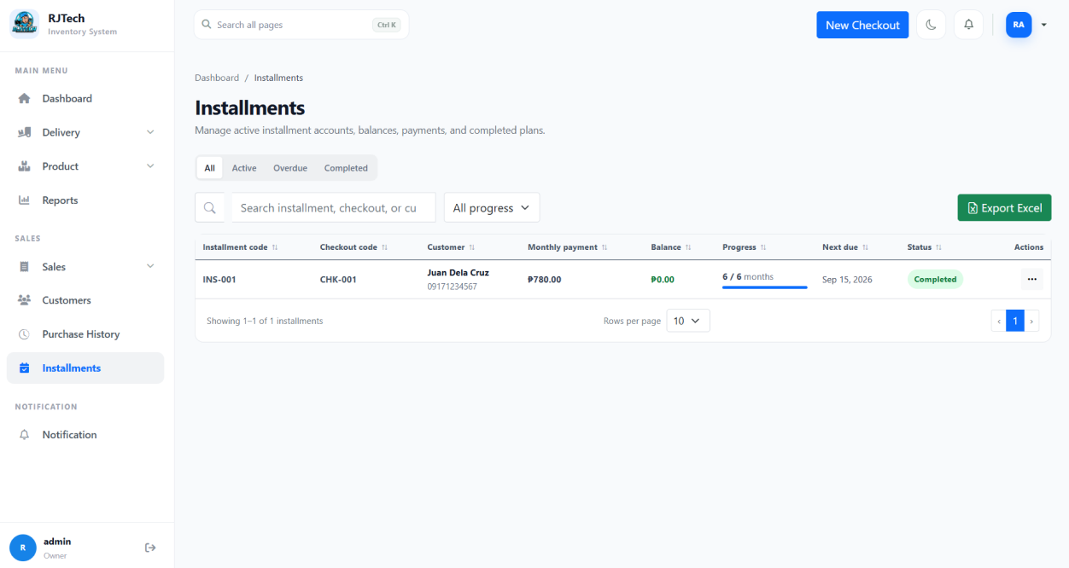
User Interface (UI)

Slide 22
Class Diagram

Slide 23
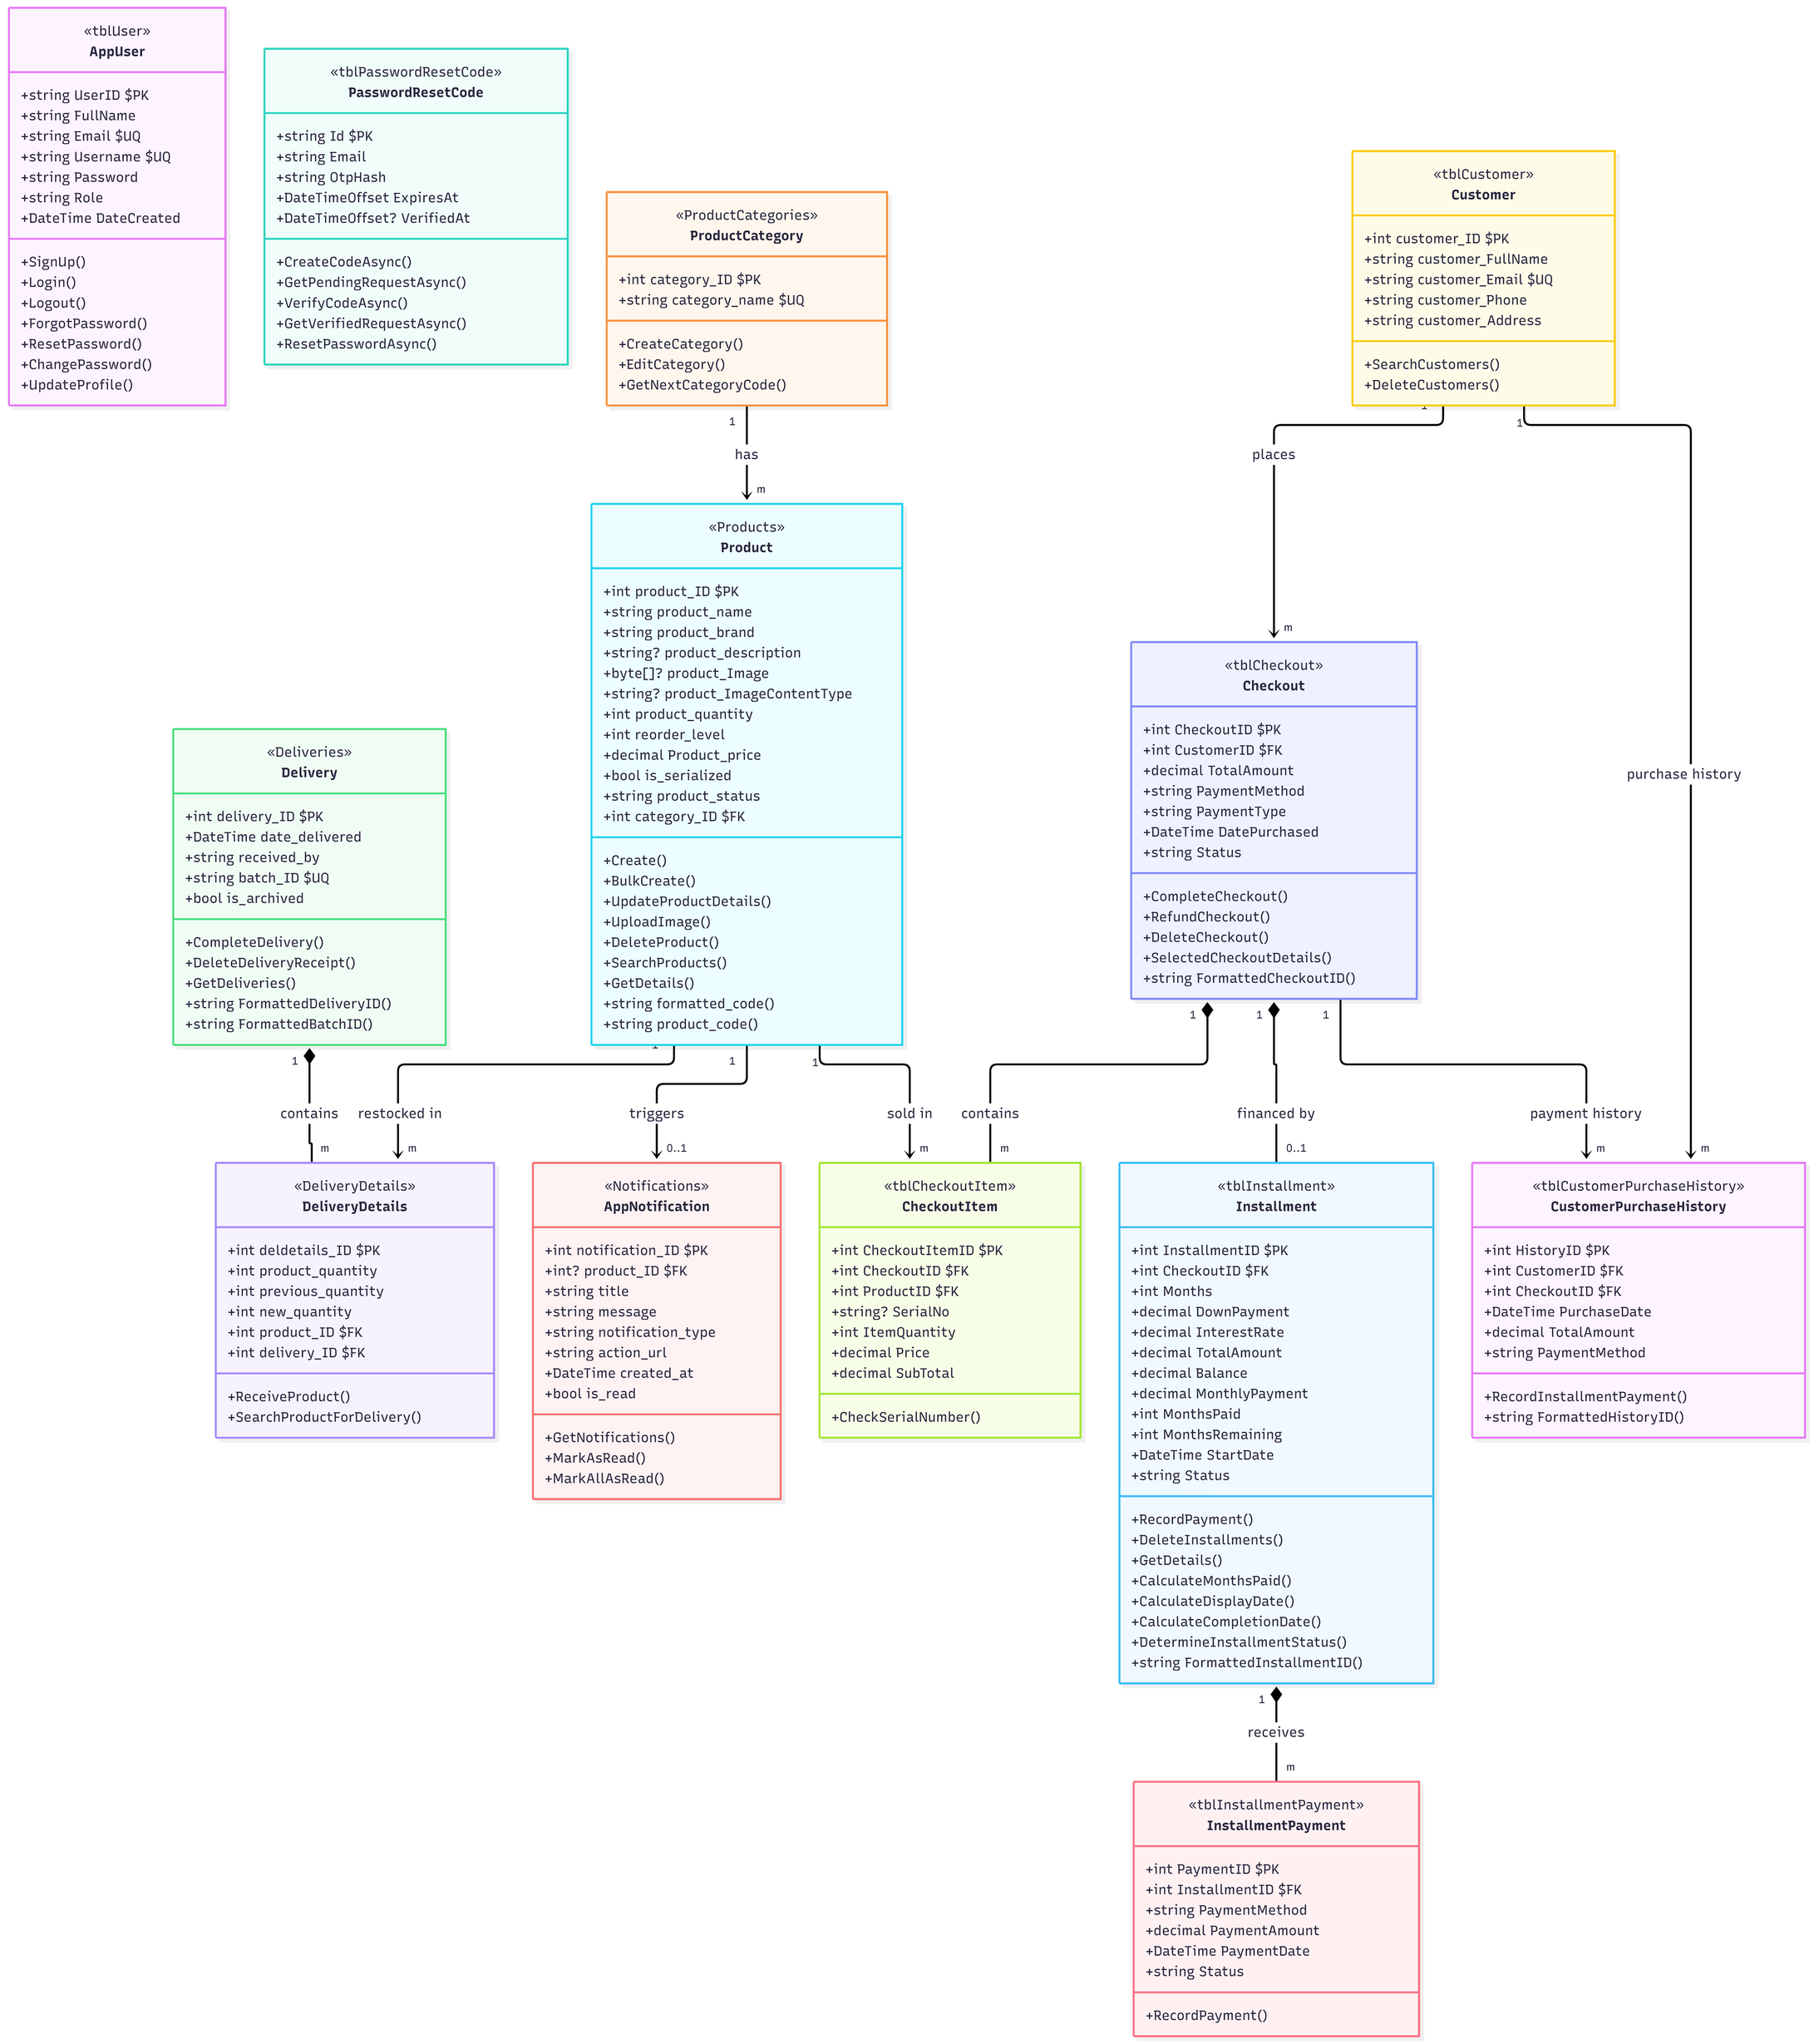

Class Model

Slide 24
THANK YOU

